Slide 1

Sync+ 2.0
Phase4_MY23 P702_R07 HF1 –Baidu
Baidu
Updated on 2022-08-18
Desired Outcome
Awareness
Decision
Escalation Help
Think
Point of view
Plan to Implement
Implement

Slide 2
{MY23 P702_R07 HF1} Software overall status {Green}
Software key info
Refer SWAD for the details:
MCU version: 20220726_501_PRO
SOC User version: 20220814_0765_A3F12_R07.PRO.HF1
Verification scope and method:
{Full verification} executed with pass rate 98%, 0 P1 and 15 P2 issues found and not fixed. Refer test report for detail.
Main changes compared with previous version, refer RN for the details, highlights listed below:
Open AIMS with risk evaluation – refer slide 3
Memory leak, VR project test – refer slide 4、5、6
Performance test – refer slide 7
Notes:
Add P1 weekly burn down chart

Slide 3
{MY23 P702 R07 HF1} Open AIMS with risk evaluation
NA
Notes:
Add P1 weekly burn down chart

Slide 4
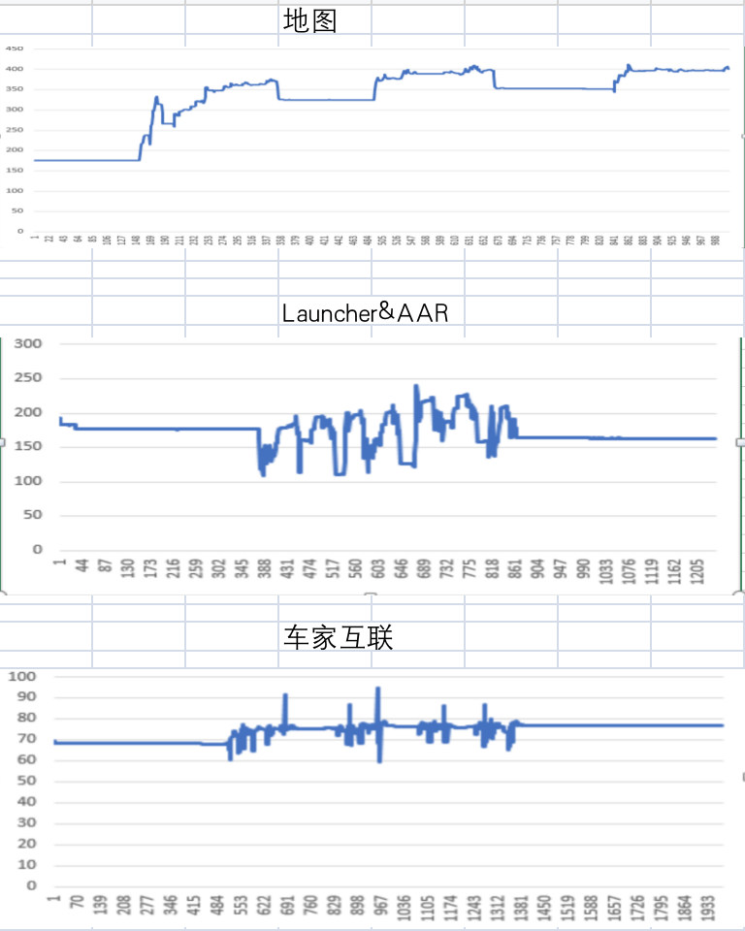
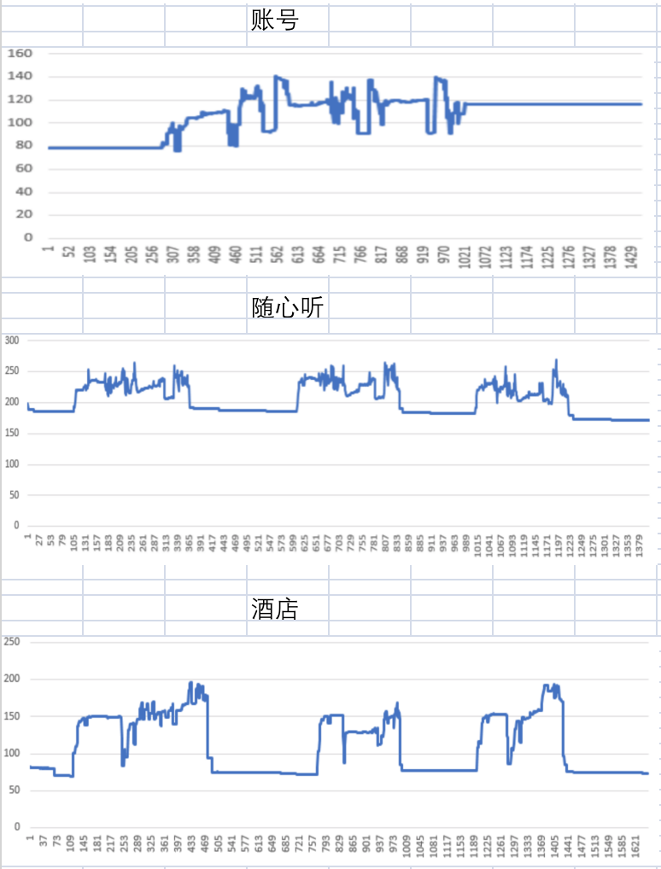
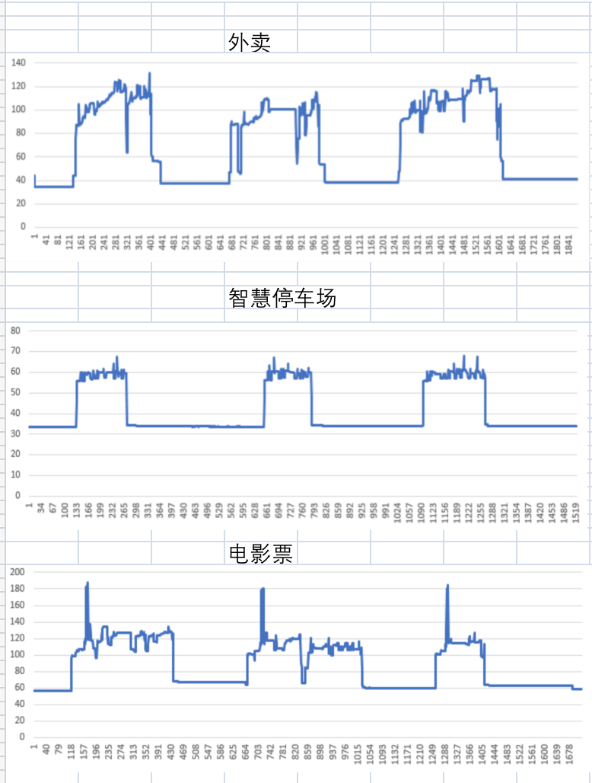
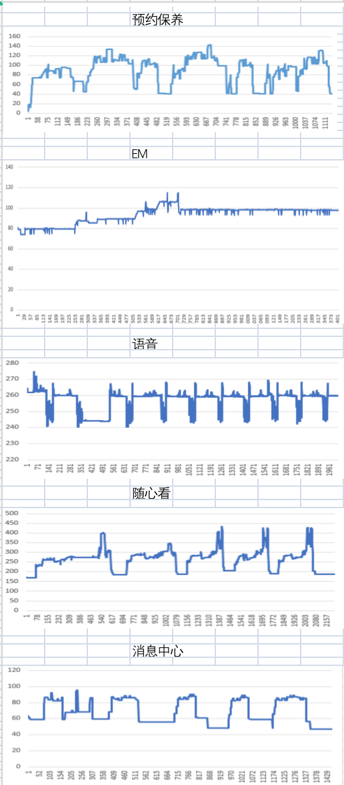
{MY23 P702_ R07 HF1} 内存泄漏专项测试

Slide 5
{MY23 P702_ R07 HF1} 语音专项测试
唤醒词唤醒率： Pass
唤醒词唤醒率
AI能力 | 指标项 | 通过标准 | 实测结果 | 测试结论
小度小度 | 低噪 | 92% | 100% | PASS
 | 中噪 | 90% | 99% | PASS
 | 高噪 | 85% | 98% | PASS
你好福特 | 低噪 | 92% | 100% | PASS
 | 中噪 | 90% | 100% | PASS
 | 高噪 | 85% | 99% | PASS
场景化命令词识别率
AI能力 | 指标项 | 通过标准 | 实测结果 | 测试结论
暂停播放 | 低噪 | 85% | 100% | PASS
 | 中噪 | 85% | 99% | PASS
 | 高噪 | 80% | 95% | PASS
继续播放 | 低噪 | 85% | 100% | PASS
 | 中噪 | 85% | 100% | PASS
 | 高噪 | 80% | 100% | PASS
上一首 | 低噪 | 85% | 99% | PASS
 | 中噪 | 85% | 98% | PASS
 | 高噪 | 80% | 100% | PASS
上一曲 | 低噪 | 85% | 96% | PASS
 | 中噪 | 85% | 96% | PASS
 | 高噪 | 80% | 88% | PASS
下一首 | 低噪 | 85% | 90% | PASS
 | 中噪 | 85% | 94% | PASS
 | 高噪 | 80% | 89% | PASS
下一曲 | 低噪 | 85% | 96% | PASS
 | 中噪 | 85% | 95% | PASS
 | 高噪 | 80% | 96% | PASS
接听电话 | 低噪 | 85% | 100% | PASS
 | 中噪 | 85% | 99% | PASS
 | 高噪 | 84% | 98% | PASS
挂断电话 | 低噪 | 84% | 99% | PASS
 | 中噪 | 84% | 100% | PASS
 | 高噪 | 84% | 98% | PASS
场景化命令词识别率
AI能力 | 指标项 | 通过标准 | 实测结果 | 测试结论
跟随模式 | 低噪 | 85% | 100% | PASS
 | 中噪 | 85% | 100% | PASS
 | 高噪 | 80% | 98% | PASS
车头朝上 | 低噪 | 85% | 100% | PASS
 | 中噪 | 85% | 99% | PASS
 | 高噪 | 80% | 95% | PASS
正北模式 | 低噪 | 85% | 99% | PASS
 | 中噪 | 85% | 96% | PASS
 | 高噪 | 80% | 96% | PASS
放大地图 | 低噪 | 85% | 100% | PASS
 | 中噪 | 85% | 98% | PASS
 | 高噪 | 80% | 98% | PASS
缩小地图 | 低噪 | 85% | 100% | PASS
 | 中噪 | 85% | 100% | PASS
 | 高噪 | 80% | 99% | PASS
打开路况 | 低噪 | 85% | 100% | PASS
 | 中噪 | 85% | 100% | PASS
 | 高噪 | 80% | 99% | PASS
关闭路况 | 低噪 | 85% | 99% | PASS
 | 中噪 | 85% | 100% | PASS
 | 高噪 | 80% | 100% | PASS
开始导航 | 低噪 | 85% | 100% | PASS
 | 中噪 | 85% | 95% | PASS
 | 高噪 | 80% | 90% | PASS
场景化命令词识别率
AI能力 | 指标项 | 通过标准 | 实测结果 | 测试结论
查看全程 | 低噪 | 85% | 100% | PASS
 | 中噪 | 85% | 100% | PASS
 | 高噪 | 80% | 98% | PASS
继续导航 | 低噪 | 85% | 99% | PASS
 | 中噪 | 85% | 100% | PASS
 | 高噪 | 80% | 98% | PASS
上一页 | 低噪 | 85% | 98% | PASS
 | 中噪 | 85% | 95% | PASS
 | 高噪 | 80% | 89% | PASS
下一页 | 低噪 | 85% | 100% | PASS
 | 中噪 | 85% | 100% | PASS
 | 高噪 | 80% | 95% | PASS
确定 | 低噪 | 85% | 100% | PASS
 | 中噪 | 85% | 96% | PASS
 | 高噪 | 80% | 91% | PASS
取消 | 低噪 | 85% | 100% | PASS
 | 中噪 | 85% | 98% | PASS
 | 高噪 | 80% | 100% | PASS
第一个 | 低噪 | 85% | 100% | PASS
 | 中噪 | 85% | 94% | PASS
 | 高噪 | 80% | 99% | PASS
第二个 | 低噪 | 85% | 100% | PASS
 | 中噪 | 85% | 100% | PASS
 | 高噪 | 80% | 100% | PASS
第三个 | 低噪 | 85% | 99% | PASS
 | 中噪 | 85% | 100% | PASS
 | 高噪 | 80% | 99% | PASS

Slide 6
{MY23 P702_ R07 HF1} 语音专项测试
误唤醒测试：Pass
AI能力 | 测试时长 | 通过标准 | 实测结果 | 测试结论
小度小度 | 测试场景/时长 | <0.3次/h | 0 | PASS
你好福特 | 静态测试 | <1.2次/h | 0 | PASS
小度小度 | （互相聊天对话）4小时 | <0.3次/h | 0 | PASS
你好福特 | 播放爱情公寓5 | <1.2次/h | 0 | PASS

Slide 7
{MY23 P702_ R07 HF1} 性能测试
序号 | 影响因素 | Reference | R07 | R06 | 偏差 | 分析
1 | Power on QQ音乐首次启动 | 4s | 1.926666667 | 5 | -61.47%
2 | Power onQQ音乐选择歌单 | 1s | 2.228333333 | 2.3 | -3.12%
3 | Power onQQ音乐选择歌曲 | 1s | 2.016666667 | 1.9 | 6.14% | 正常范围波动
4 | Power on导航启动时间 | 12.2s | 9.768333333 | 14.82 | -34.09%
5 | power on导航界面点击输入框出现下拉框 | 1s | 0.196333333 | 0.22 | -10.76%
6 | power on导航搜索地址完成 | 1.5s | 2.676 | 2.8 | -4.43%
7 | power on选择目的地后路线规划完成 | 2s | 1.730666667 | 1.88 | -7.94%
8 | Power onPTT可用 | 15.2s | 12.164 | 13.2 | -7.85%
9 | Power on语音可用 | 15.2s | 13.078 | 20.329 | -35.67%
10 | Power on语音播放音乐 | 5s | 28.00333333 | 27.66 | 1.24% | 正常范围波动
11 | Power onFM/在线电台音源恢复 | 6.2s | 2.789666667 | 4.578333333 | -39.07%
12 | Power on到根目录两首歌的USB音源恢复 | 18.2s | 3.063 | 3.236666667 | -5.37%
13 | Power onQQ音源恢复 | 18.2s | 8.669666667 | 8.013666667 | 8.19% | 正常范围波动
14 | CPU常用场景一下归一化CPU Free | >60% for 400% | 284.8 | NA | NA | R06无实车，R07基于实车路试测试，内部确认属于正常值
15 | CPU常用场景二下归一化CPU Free | >60% for 400% | 212.4 | NA | NA | R06无实车，R07基于实车路试测试，内部确认属于正常值
16 | CPU常用场景三下归一化CPU Free | >60% for 400% | 212.4 | NA | NA | R06无实车，R07基于实车路试测试，内部确认属于正常值
17 | CPU Worst case下归一化CPU Free | >60% for 400% | 310.2 | NA | NA | R06无实车，R07基于实车路试测试，内部确认属于正常值
18 | RAM常用场景一下归一化RAM Free | >30% | 1308753.6 | NA | NA | R06无实车，R07基于实车路试测试，内部确认属于正常值
19 | RAM常用场景二下归一化RAM Free | >30% | 无此功能 | NA | NA
20 | RAM常用场景三下归一化RAM Free | >30% | 无此功能 | NA | NA
21 | RAM Worst case下归一化RAM Free | >30% | 279527.4 | NA | NA | R06无实车，R07基于实车路试测试，内部确认属于正常值
22 | GPU常用场景一下归一化GPU Free | >40% | 69.2 | NA | NA | R06无实车，R07基于实车路试测试，内部确认属于正常值
23 | GPU常用场景二下归一化GPU Free | >40% | 89.8 | NA | NA | R06无实车，R07基于实车路试测试，内部确认属于正常值
24 | GPU常用场景三下归一化GPU Free | >40% | 87.8 | NA | NA | R06无实车，R07基于实车路试测试，内部确认属于正常值
25 | 系统稳定状态下QQ音乐首次启动 | 1.5s | 1.282 | 2.417666667 | -46.97%
26 | 系统稳定状态下QQ音乐选择歌单 | 1.5s | 1.659666667 | 1.73 | -4.07%
27 | 系统稳定状态下QQ音乐选择歌曲 | 1.5s | 1.883 | 1.92 | -1.93%
28 | 系统稳定状态下USB音乐首次启动 | 1.5s | 1.659666667 | 3.431 | -51.63%

Slide 8
{MY23 P702_ R07 HF1} 性能测试
序号 | 影响因素 | Reference | R07 | R06 | 偏差 | 分析
29 | 系统稳定状态下喜马拉雅首次启动 | 1.5s | 1.413 | 1.52 | -7.04%
30 | 系统稳定状态下Navigation首次启动 | 3s | 4.347666667 | 5.483333333 | -20.71%
31 | 系统稳定状态下导航界面点击输入框出现下拉框 | 1s | 0.340333333 | 0.41 | -16.99%
32 | QQ/新闻/喜马拉雅/在线FM热启动 | 200ms | 313.3333333 | 541 | -42.08%
33 | USB音乐热启动 | 200ms | 497.3333333 | 891.6666667 | -44.22%
34 | Navigation热启动 | 200ms | 260 | 197 | 31.98% | 毫秒为单位对客户无感知可忽略
35 | 24小时Monkey测试中的CPU Free | >60% for 400% | 242 | 256.3333333 | -5.59%
36 | IVI路测常用场景1H后开启后倒车 |  | 1.333333333 | NA | NA | R06无实车，R07基于实车测试，内部确认属于正常值
37 | 系统稳定状态下导航搜索 | 1s | 2.371666667 | 1.91 | 24.17% | 相差不到1S不影响用户体验
38 | 系统稳定状态下导航路径规划 | 1s | 1.772333333 | 1.816666667 | -2.44%
39 | 系统稳定状态下在线QQ音乐切歌 | 1s | 0.668333333 | 1.414666667 | -52.76%
40 | 系统稳定状态下在线电台切换/FM | 1s | 0.704666667 | 1.27 | -44.51%

